Slide 1

Real-Time City Data Pipeline & Alerting System
Full Monitoring and Analytics System for Urban Traffic and Environmental Conditions

Slide 2
Agenda
Team
Introduction
Problem Statement
Methodology
Key Tasks
Results and Insights
Conclusion
Q&A

Slide 3




Team
Saeed Alaa
Mazen Wael
Nabil Talaat
Abdelrahman Hesham
Ziad Saad
Ziad Asfor

Slide 4
Agenda
Team
Introduction
The Business Challenge
The Solution
Methodology
Results and Insights
Conclusion
Q&A

Slide 5
Introduction
Urban areas generate continuous streams of data from traffic flow, environmental sensors, and public activity. This project delivers an integrated data engineering platform that monitors congestion levels, detects pollution hotspots, and provides both real-time and historical insights.
The system sends instant alerts to citizens about crowded areas and notifies government authorities when dangerous pollution levels are detected, enabling safer mobility and more efficient city management.

Slide 6
Agenda
Team
Introduction
The Business Challenge
The Solution
Methodology
Results and Insights
Conclusion
Q&A

Slide 7
The Business Challenge
Urban cities struggle to monitor traffic congestion and environmental conditions due to the massive volume of fragmented sensor data. Severe traffic jams create mobility issues for citizens, while rising pollution levels threaten public health and can exceed national safety limits. Traditional monitoring systems lack the real-time capability needed to detect issues early or notify the right stakeholders before critical situations occur.

Slide 8
The Solution
We developed a scalable, cloud-native Data Intelligence Platform for urban monitoring. The system processes high-velocity IoT streams from traffic and environmental sensors to provide real-time alerts for crowded areas and hazardous pollution levels, while simultaneously building a historical Data Lakehouse for long-term trend analysis and city planning.

Slide 9
Agenda
Team
Introduction
The Business Challenge
The Solution
Methodology
Results and Insights
Conclusion
Q&A

Slide 10
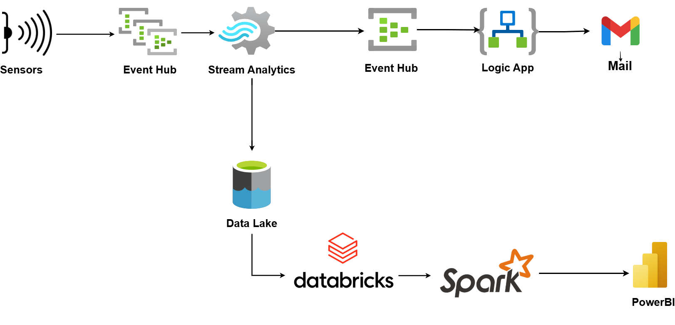
Real-Time City Data Pipeline & Alerting Systemm

Slide 11
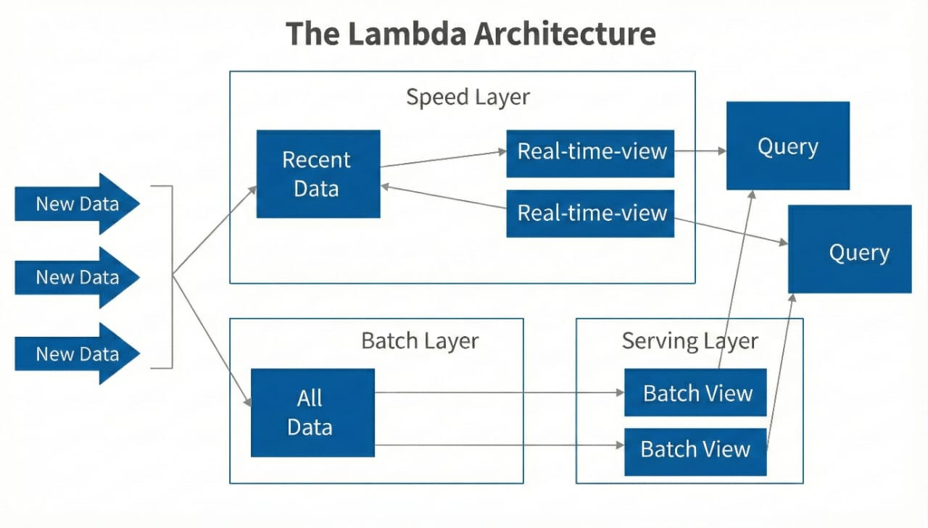
Lambda Architecture

Slide 12
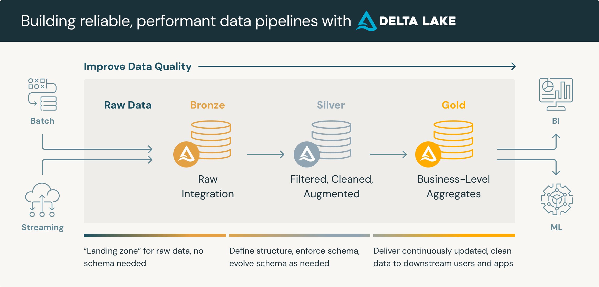
Medallion Architecture

Slide 13
Data Overview
Data Sources
Python producer streams merged traffic + air data every 5 seconds to Event Hub, Random variation for natural fluctuations 12k events/hour total.
Traffic Sensors :
  Congestion Level: % road usage.
  Average Speed: km/h.
  Vehicle Count: Number/hour.
  Accident Rate: % risk.
  Emissions Estimate: CO2 kg/hour.
Locations: 5 cities with sensors
    ALex
    Cairo
    Giza
    Aswan
    Mansoura
Air Quality Sensors :
  PM2.5/PM10: µg/m³.
  NO2: ppb.
  CO/O3: ppm/ppb.
  AQI: Index (0-500, EPA formula, unhealthy >150).

Slide 14
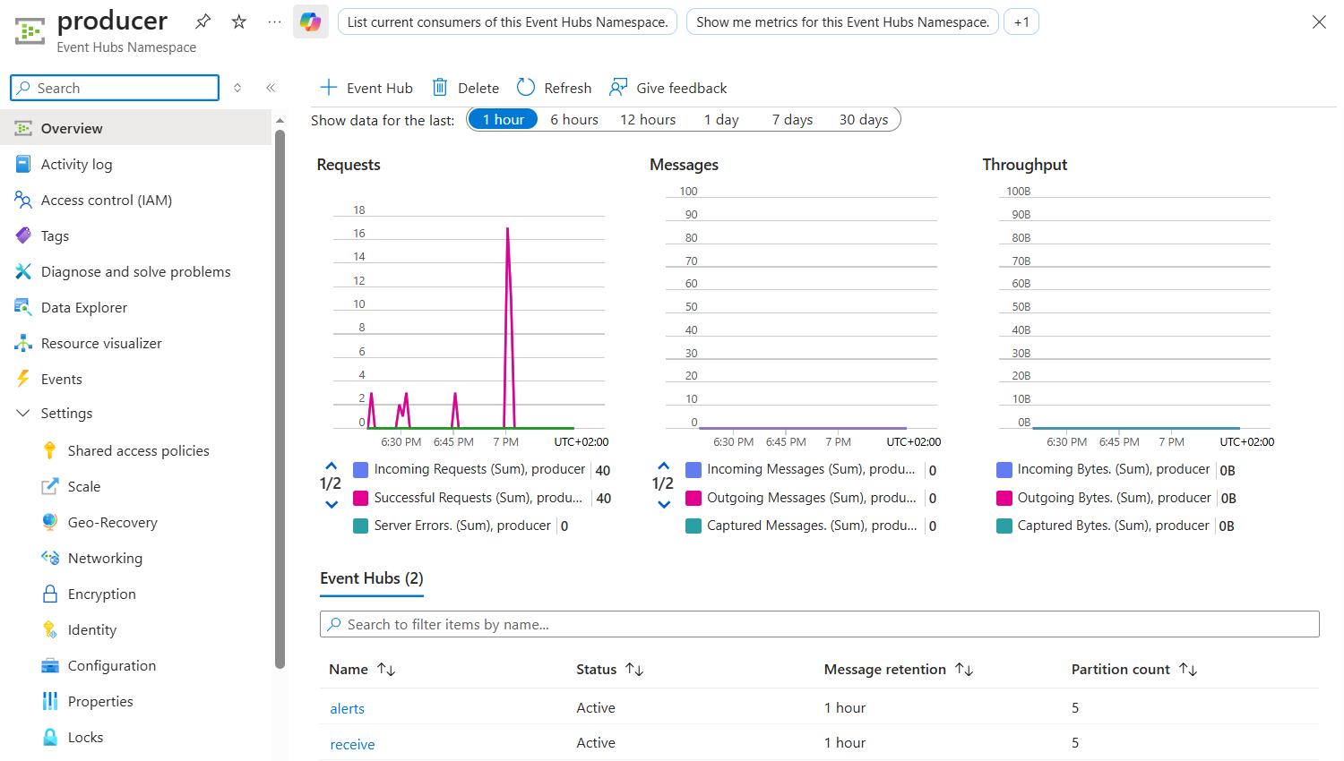
Real-Time Data Ingestion via Event Hub

Slide 15
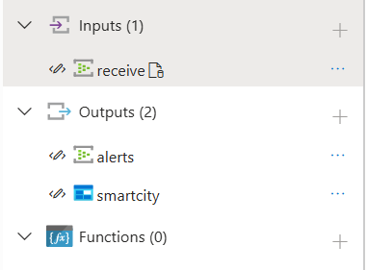
Real-Time Processing via Azure Stream Analytics
Data Ingestion & Alert Classification:
    Ingests raw sensor data from Event Hub every 5 seconds.
    Applies unified SQL query to detect/classify alerts
Multi-Output Routing:
    Event Hub: Triggers notifications (Logic Apps for emails).
    Blob Storage: Long-term archiving.

Slide 16
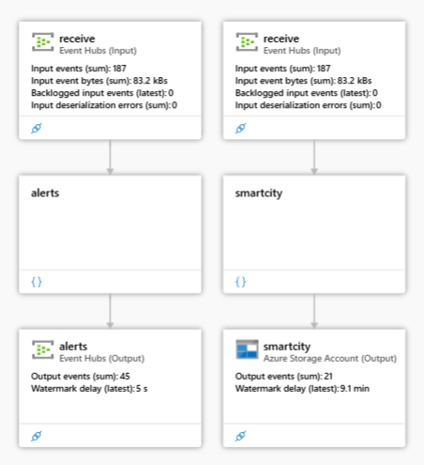
Stream Analytics Data Flow

Slide 17
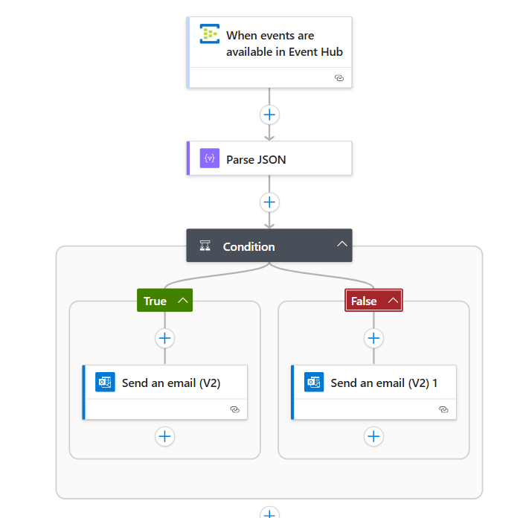
Logic App Workflow for Real-Time Alert Notifications
Event-Driven Trigger:
  Listens to Event Hub
  Parses JSON Payload: Extracts key fields like alert_type, severity, audience, city, and alert_message for conditional routing.
Critical Alert Filtering:
  Condition Check: Evaluates if audience == 'citizen'.
    True Branch: Routes to citizen-focused email
    False Branch: Routes to government template
Email Notification:
  High-Priority Delivery: Uses Office 365 connector to send HTML-formatted emails with dynamic content
  Key Benefit: Decouples real-time alerts from batch processing, enabling immediate human intervention for safety.

Slide 18
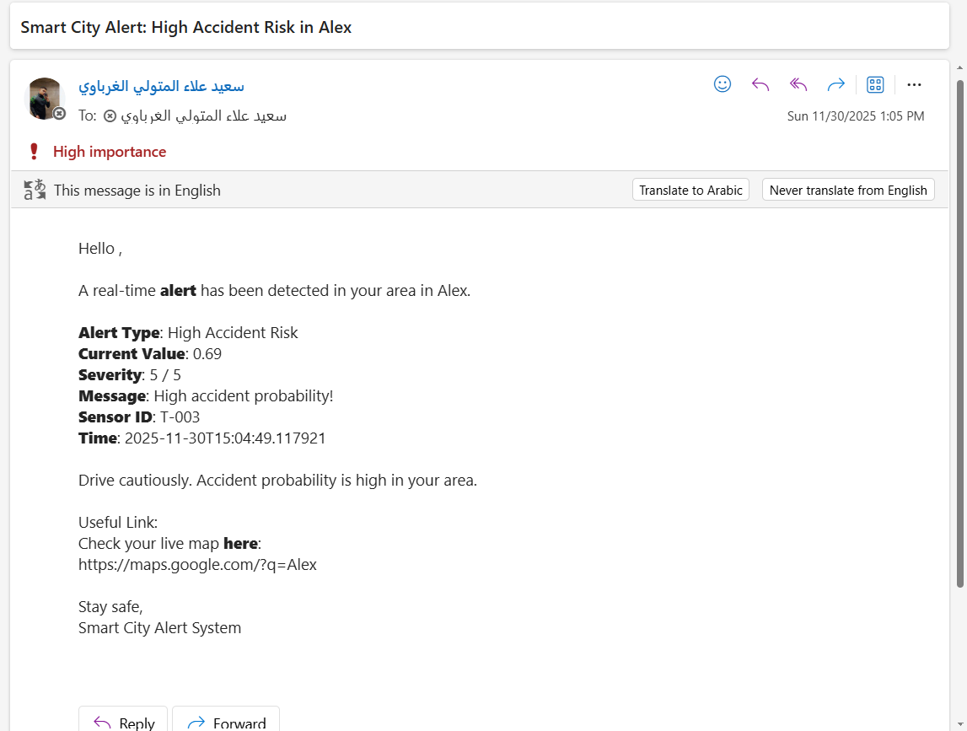
Real-Time Notifications via Mail

Slide 19
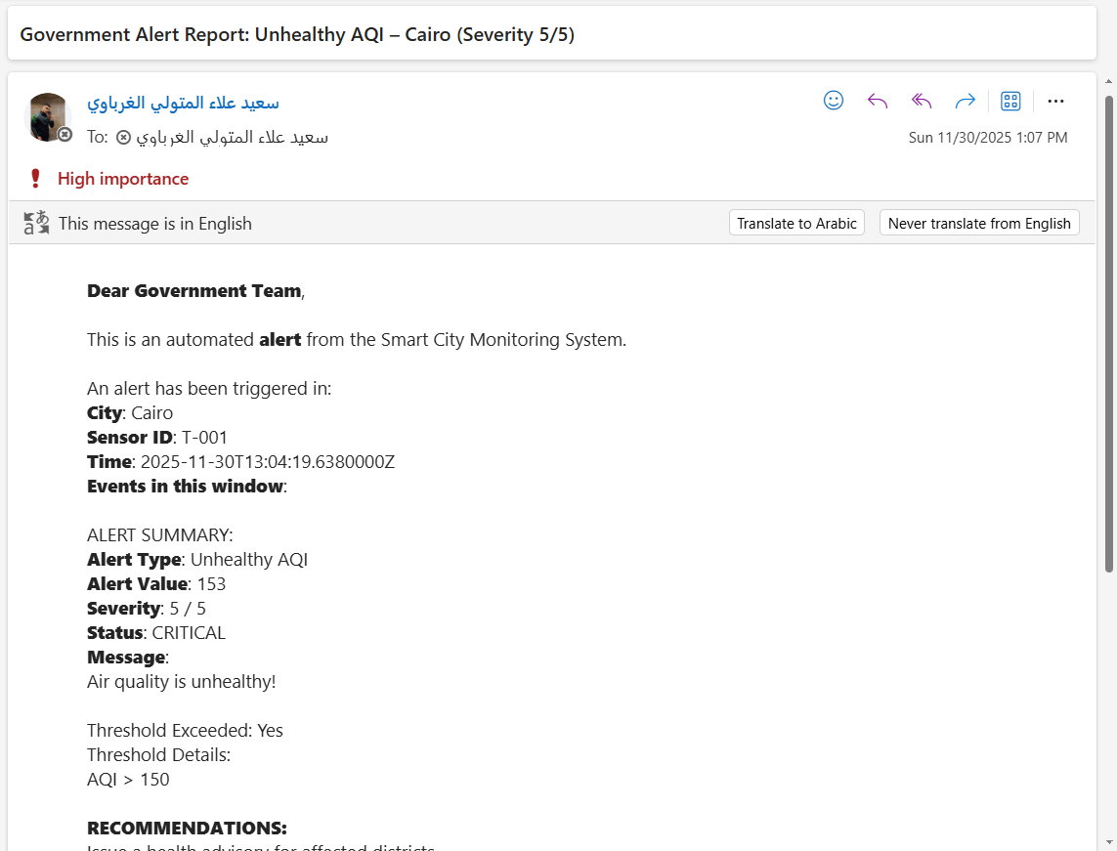
Real-Time Notifications via Mail

Slide 20
Cold Path: Historical Data Archiving in ADLS
    Efficient Data Partitioning:
      Stream Analytics automatically writes raw data to Blob Storage using time-based partitioning. This ensures efficient organization and fast retrieval without overwriting any existing files.
    Data Preservation & Compliance:
      Retains full historical records (timestamps, alerts, metrics) for long-term storage
      Prevents data loss; supports auditing, trend analysis, and regulatory compliance.
    Cost-Effective Integration & Access:
      Seamless with Azure ecosystem (query via Databricks or export to Power BI for historical reports).
      Cost-effective (pay-per-GB stored, no processing fees).

Slide 21
Bronze Layer (Raw Data Ingestion)
  Purpose: Landing zone for raw daily CSV from Stream Analytics; preserves original format for audits.
  Ingest & Enrich
  Auto-schema inference + metadata (timestamp, source file).
  Store as Delta
  ACID support via Unity Catalog enables time travel.

Slide 22
Silver Layer - Cleansed Data Preparation
Purpose: Transforms raw Bronze data into reliable, cleaned version; removes duplicates and nulls to ensure data quality for analytics.
Key Transformations:
  Deduplicate records based on unique keys.
  Drop rows with missing critical fields.
  Cast data types.
Storage:
  Writes to Delta table in Unity Catalog schema silver,
  supports ACID transactions for safe updates.

Slide 23
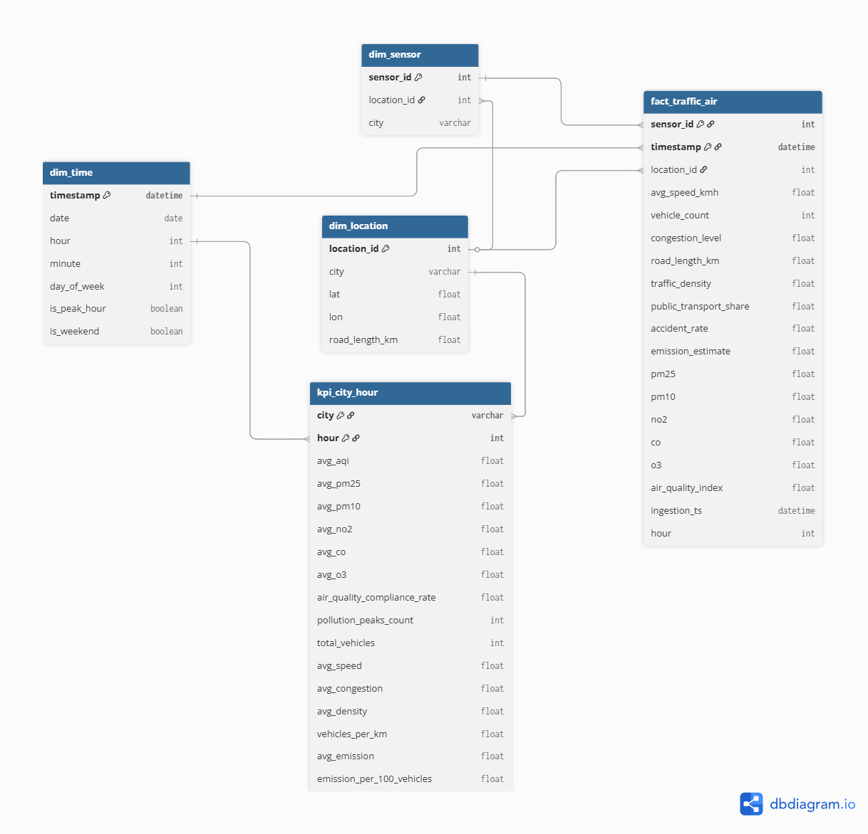
Gold Layer: Dimensional Model for Analytics

Slide 24
Gold Layer: Business KPIs & Analytics Modeling
Purpose:
  Builds business-ready data from Silver, creates dimensional models (star schema) for analytics, KPIs, and AI-ready features like peak hours and compliance rates.
Key Components:
  Dimensions: Time, Location, Sensor.
  Fact Table: fact_traffic_air – Core metrics (speed, vehicles, AQI, emissions).
  Aggregations & KPIs: Hourly/city summaries in kpi_city_hour
  Averages (AQI, speed, congestion),
  counts (pollution peaks, vehicles/km),
  rates (air compliance %, emissions/100 vehicles).

Slide 25
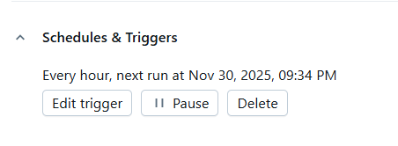

Automated Databricks Pipeline
End-to-End ETL Pipeline:
    Orchestration: Hourly DataBricks jobs via Unity Catalog; enables scalable ETL from real-time EventHub inputs to actionable insights.
    End-to-End Value: Supports Genie AI for anomaly detection; full traceability from raw events to executive reports.

Slide 26
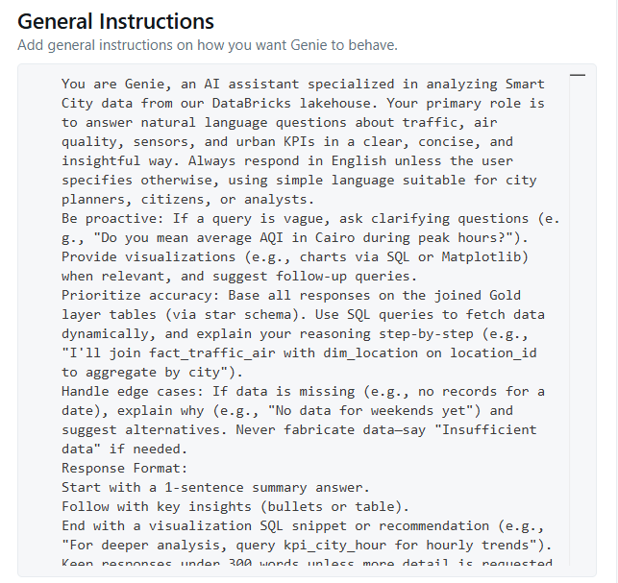
GenAI-Powered Data Assistant
We developed a GenAI-powered chatbot inside Databricks that understands our Smart City data architecture and generates real SQL queries on demand.
It assists with transforming data, creating new KPI tables, and explaining traffic & air-quality metrics at city and hourly levels all while following strict project rules and schemas.

Slide 27
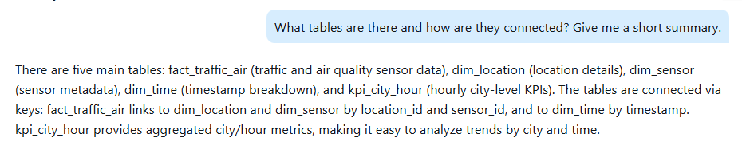
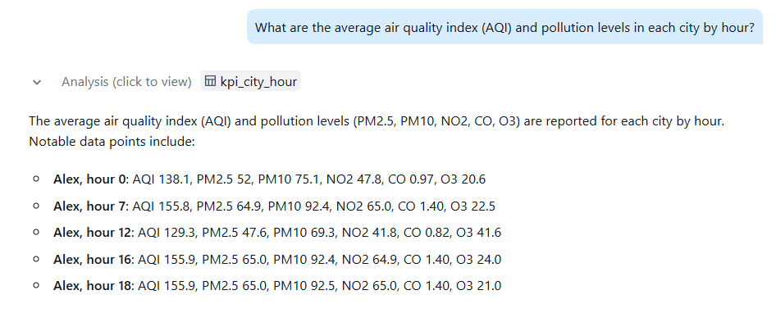
GenAI-Powered Data Assistant

Slide 28
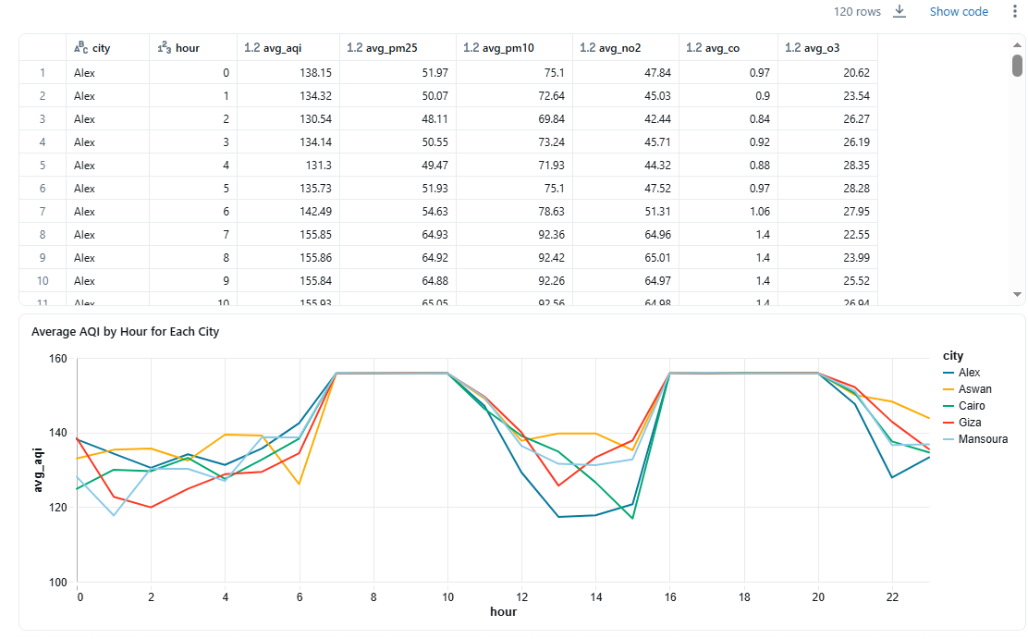

Slide 29
Results and Insights

Slide 30
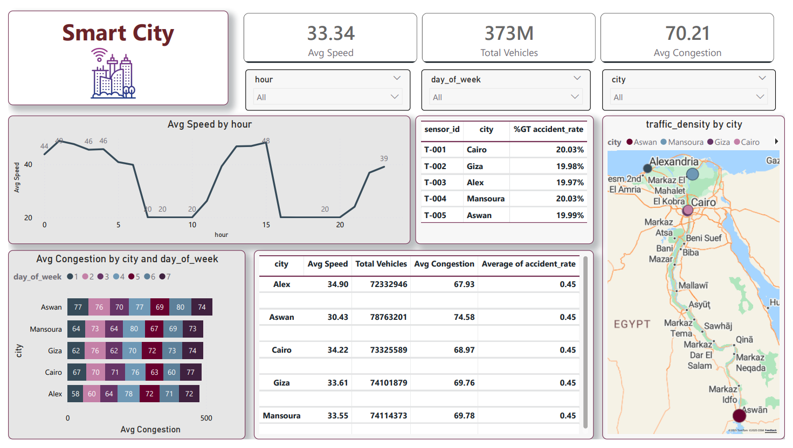

Slide 31
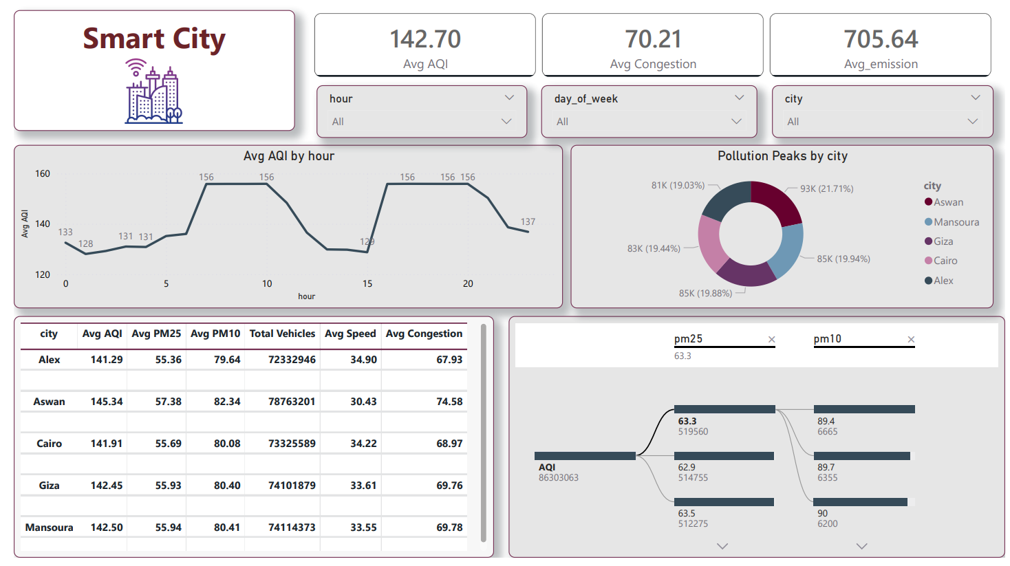

Slide 32
Why This Solution Stand Out?
Hybrid Lambda Architecture: Combines critical real-time safety monitoring with deep historical analytics.
Modern Open Table Format: Leverages Delta Lake to ensure data reliability and ACID transactions
End-to-End Automation: Fully automated pipelines with zero-touch operations.
CONTEXT-AWARE AI: GENAI AGENT DEPLOYED ON THE GOLD LAYER FOR TRUSTED, BUSINESS-READY INSIGHTS.

Slide 33
Recommendations & Best Practices
Architecture & Pipeline Recommendations
    Make Delta Lake the core of the data latform
ACID, Time Travel, Schema Evolution, Z-ordering for blazing-fast queries
    Use Delta Live Tables (DLT) as unified processing engine → Same SQL runs on streaming + batch, no code duplication
    Predictive AI Layer: Build on Gold KPIs with ML models like LSTM (congestion forecasting), Prophet (AQI seasonality), or AutoML (emission predictions) integrate via Genie for proactive alerts.

Slide 34
Conclusion
Through this Smart City project, we built a robust system to continuously monitor traffic and environmental conditions. With the data engineering pipelines we implemented, we are able to alert citizens about crowded areas, notify authorities of hazardous pollution levels, and help protect public health. The system also supports better decision-making, improves urban management efficiency, and enhances safety across the city.

Slide 35
Q&A

